Slide 1

Independent Study Update: MMTN Week 2
Karthik 2021.10.29
AMLL

Slide 2
Overview
Further explore learned geometries
Sweep over different lambda, sigma values
Including lambda = 0

Slide 3
Geometry Exploration (I/III)
Same graph as before, with scatter plot
Don’t see the models curving in on themselves anymore

Slide 4
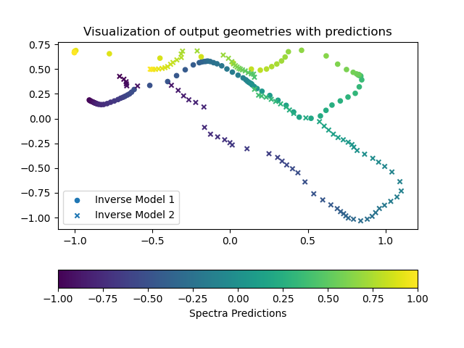
Geometry Exploration (II/III)
Color represents spectra predictions
Doesn’t seem like there is any direct overlap between models on y-values, but some do get close to each other
Seems like each model moves through x- and y-space continuously

Slide 5
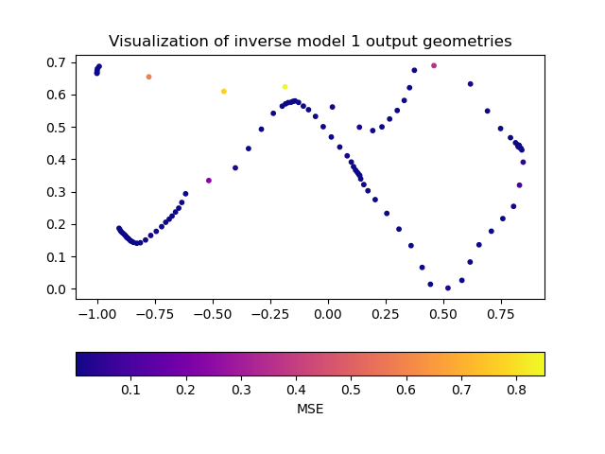
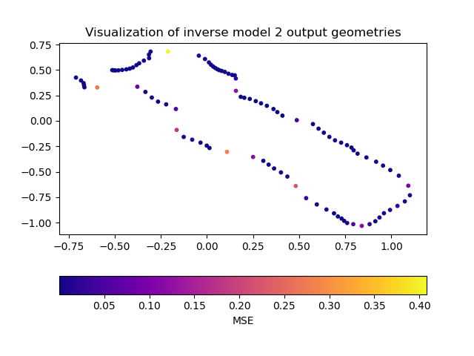
Geometry Exploration (III/III)
Color represents MSE for each prediction

Slide 6
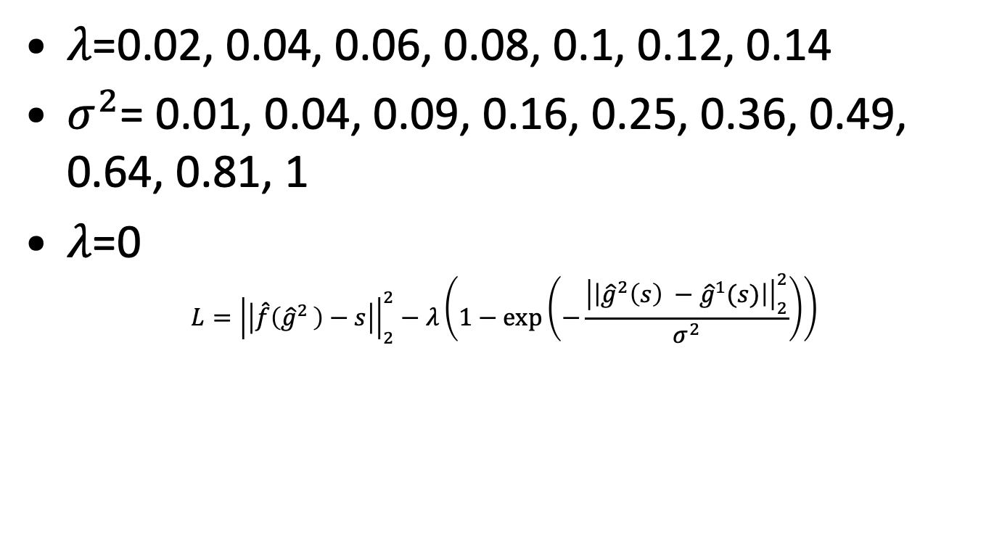
Hyperparameter sweep
$λ$=0.02, 0.04, 0.06, 0.08, 0.1, 0.12, 0.14
$σ^{2}$= 0.01, 0.04, 0.09, 0.16, 0.25, 0.36, 0.49, 0.64, 0.81, 1
$λ$=0
$$L={\left|\left|\hat{f}\left({\hat{g}}^{2 }\right)−s\right|\right|}_{2}^{2}−λ\left(1−\exp\left(−\frac{{\left|\left|{\hat{g}}^{2}\left(s\right) −{\hat{g}}^{1}(s)\right|\right|}_{2}^{2}}{σ^{2}}\right)\right)$$

Slide 7
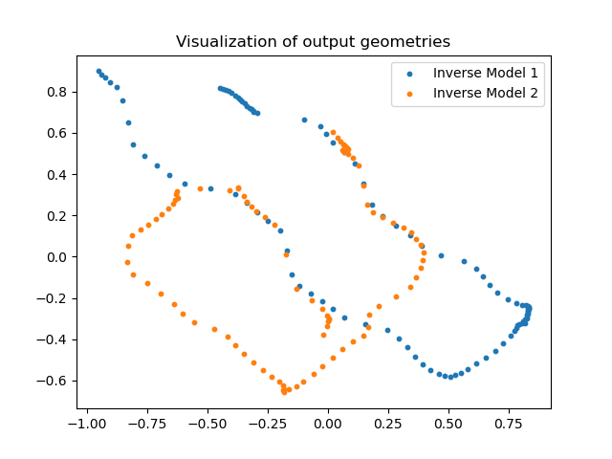
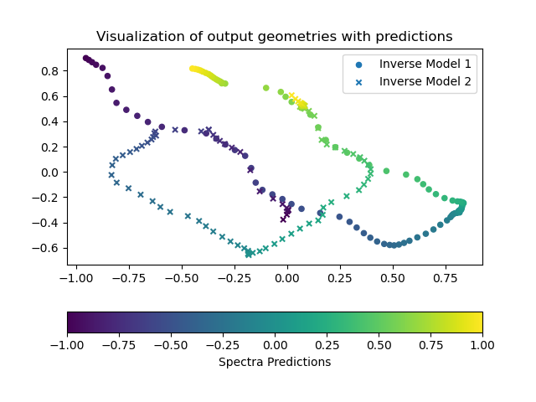
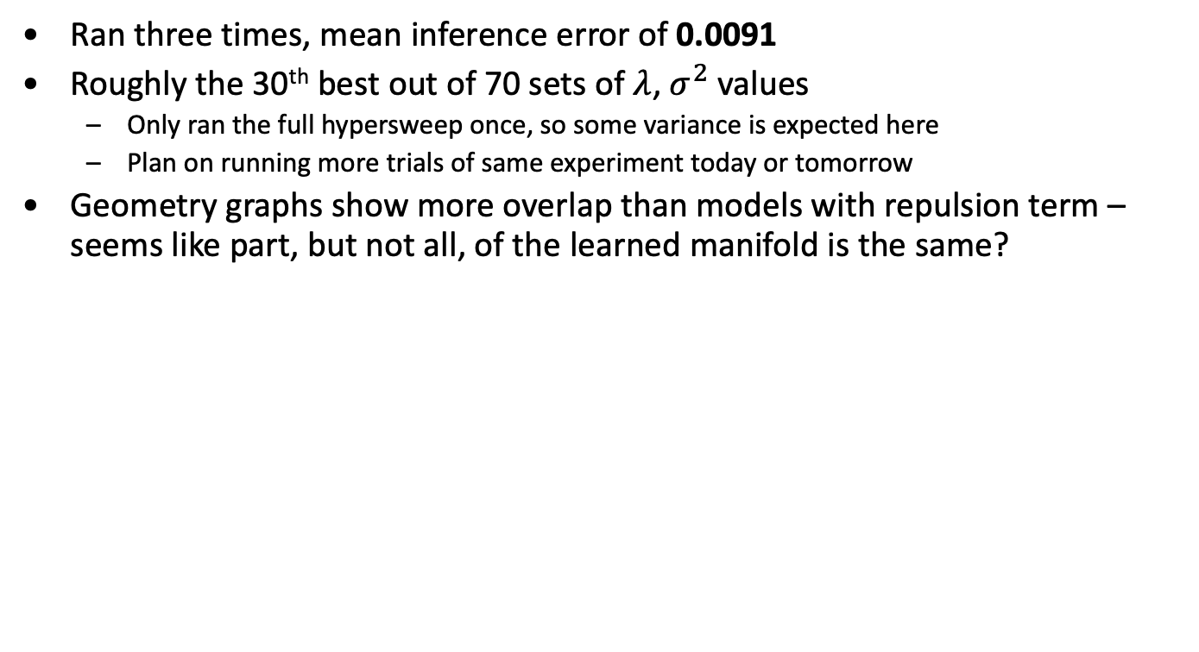

$λ$ = 0 Results
Ran three times, mean inference error of 0.0091
Roughly the 30th best out of 70 sets of $λ$, $σ^{2}$values
Only ran the full hypersweep once, so some variance is expected here
Plan on running more trials of same experiment today or tomorrow
Geometry graphs show more overlap than models with repulsion term – seems like part, but not all, of the learned manifold is the same?

Slide 8
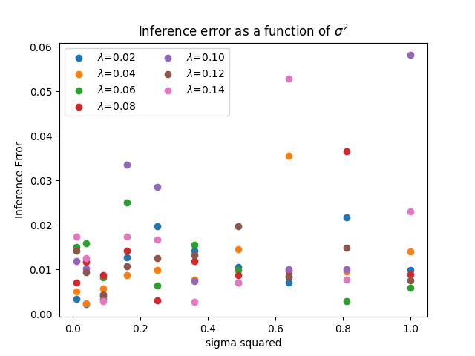
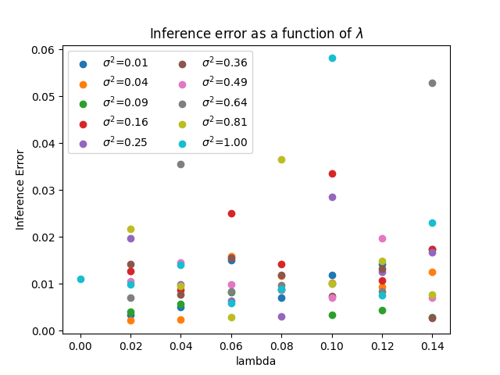
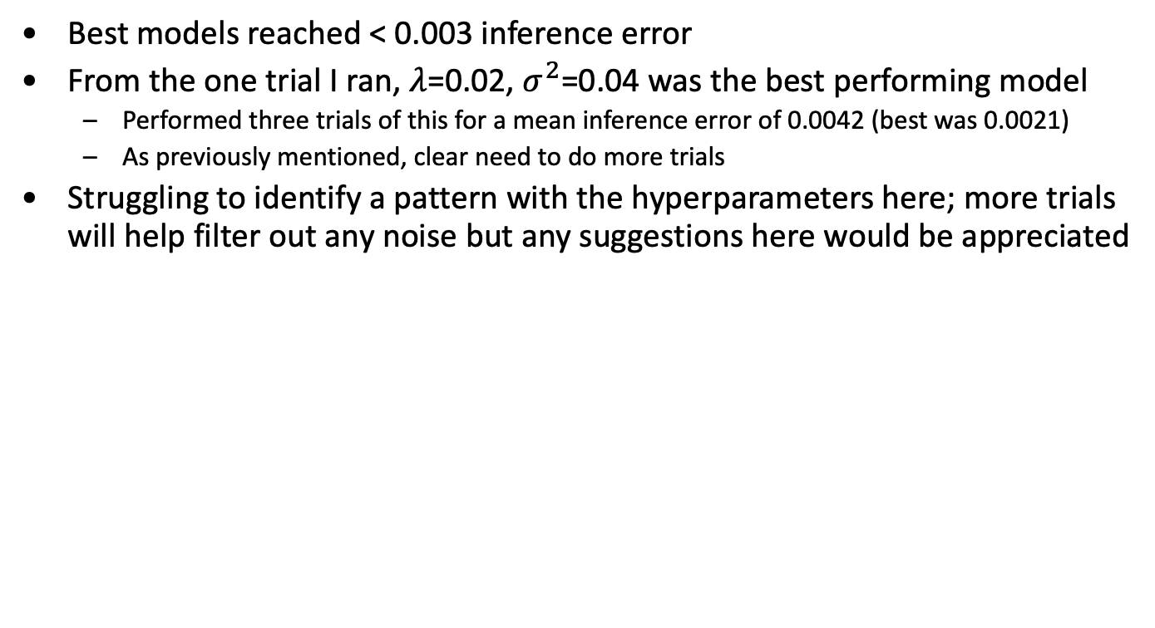
Hypersweep Results
Best models reached < 0.003 inference error
From the one trial I ran, $λ$=0.02, $σ^{2}$=0.04 was the best performing model
Performed three trials of this for a mean inference error of 0.0042 (best was 0.0021)
As previously mentioned, clear need to do more trials
Struggling to identify a pattern with the hyperparameters here; more trials will help filter out any noise but any suggestions here would be appreciated

Slide 9
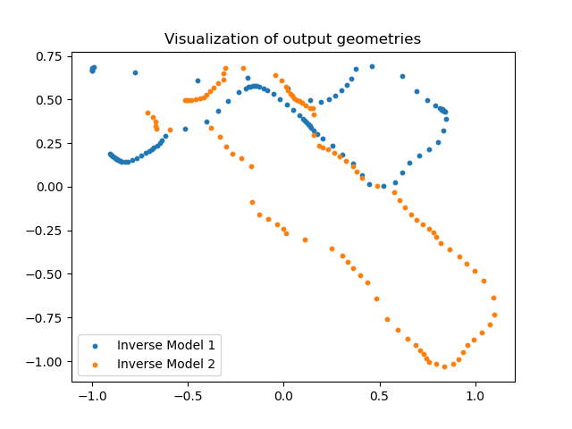

$λ$ = 0.02, $σ^{2}$=0.04 Results

Slide 10
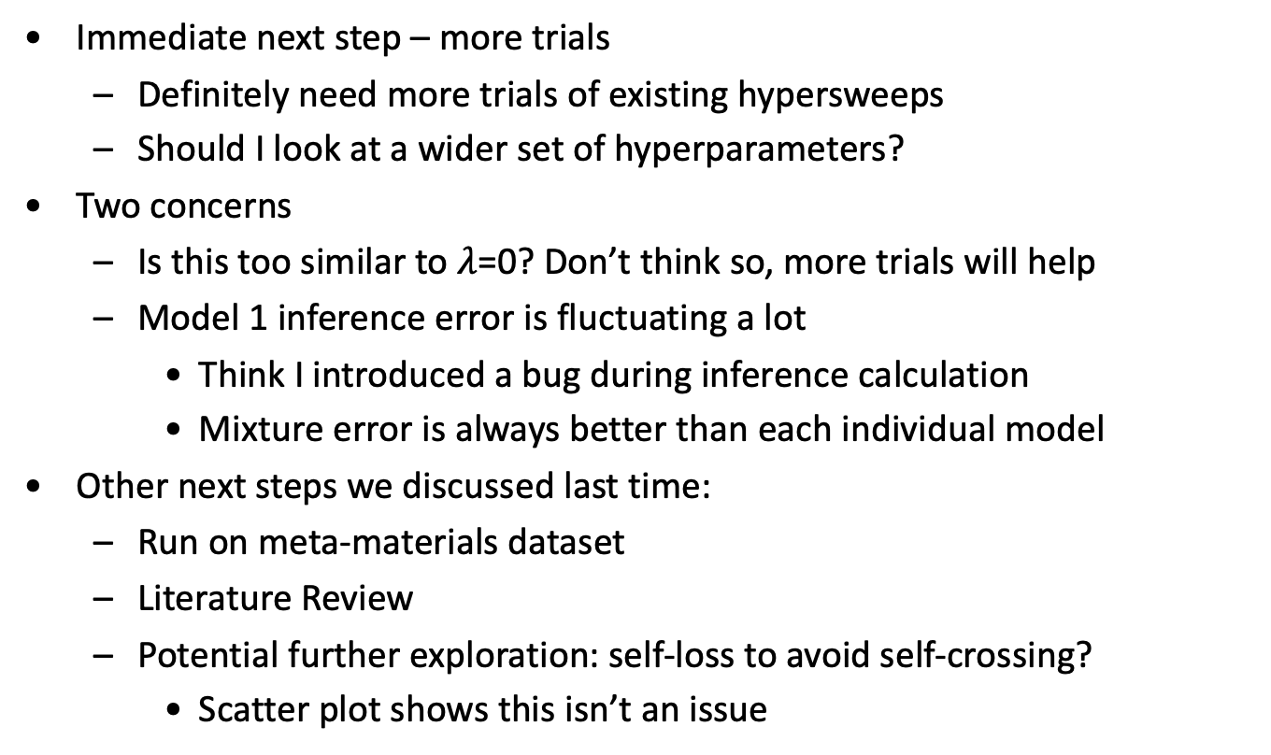
Next steps (I/II)
Immediate next step – more trials
Definitely need more trials of existing hypersweeps
Should I look at a wider set of hyperparameters?
Two concerns
Is this too similar to $λ$=0? Don’t think so, more trials will help
Model 1 inference error is fluctuating a lot
Think I introduced a bug during inference calculation
Mixture error is always better than each individual model
Other next steps we discussed last time:
Run on meta-materials dataset
Literature Review
Potential further exploration: self-loss to avoid self-crossing?
Scatter plot shows this isn’t an issue

